Slide 1
Commerce Project
Group 4

Slide 2
Team Members
Harrison R. Lara – Project Manager, Architect
Daudi Williams – Technical Lead
Madison Hubbard – Developer, QA
Sung Ho Lee – Developer, QA
Osama Esam Obadi AlHaiki – Developer, QA

Slide 3
Purpose
The purpose of this web applications is to allow users to bank and use the services provided by Commerce Bank need a web application to manage their accounts, transactions and notifications.
This website will need to use all transactions for a user across several accounts the user has with the bank.
The user will also need to be able to customize and have a default set of notifications for transactions, time, dates, balances, etc.
The scope of this project is not limited to but consists of ensuring users will be able to login or register, then be redirected to their dashboard that allows them to see notifications and a snapshot of their accounts, export data and manage notifications.

Slide 4
Objectives
The overall goal is to give users a way to manage their accounts, transactions and services with Commerce Bank.
Provide a login for existing users.
Provide a registration page for new users.
Function in a simple and intuitive manner.
Provide users with balances and transaction details for their saving, checking, money market accounts.
Provide a way for users to export all their data from each account to a spreadsheet.
Allow users to customize, create and manage notifications based on their needs for the different accounts.
Users will be able to add transactions to the desired account.
Provide a functional and logical site flow in terms of accessibility
Allow the user to update their profile.
Users will be able to logout

Slide 5
TimeLine
Delivered on or by March 02, 2020 – Iteration 1
Project Charter, Requirements Document, Project Plan
Base Login Page, Login Page Validation (email, password), Home Page Navigation, Sign Up Page (first, last, email, username, password), Sign Up and Login Page Validation, Styling of Login/ Registration pages, architecture,
System Testing, Versioning
Delivered on or by March 16, 2020 – Iteration 2
Account Balance Components (Dashboard), Retrieval of account , Notification Center on Home Page, Routes to navigate to each Balance Page
Unit Testing, System Testing, Versioning
Delivered on or by April 04, 2020 – Iteration 3
Data Grid for Checking/ Saving / Money Market Account Pages
Styling of Home, Checking, Savings, Money Market Pages
Ability to Export Account Data to CSV, Filtering and Sorting on Grid
System Testing, Security Scanning and Package Audit, Versioning

Slide 6
TimeLine
Delivered on or by April 20, 2020 – Iteration 4
Ability to Add a Transaction to Savings, Checking, Money Market Accounts
Notification Rules, Notifications Component, Ability Remove Notification from Home Screen
Unit Testing, System Testing, Security Scanning and Package Audit, Versioning
Delivered on or by May 04, 2020 – Iteration 5
Show Notification by Priority on Home Page, Ability to Add, Edit, Delete Notifications
Add Styling for Notifications, Add User Session (Stretch)
Unit Testing, System Testing, Versioning
Final release

Slide 7
Budget
Project manager at 5 hours per week for 13 weeks
65 hours * $50/hr. = $3,250
4 software engineers at 5 hours per week each for 13 weeks
260 hours * $40/hr. = $10,400
Summary
325 hours total
$13,650 total
Average of $42.00 per hour

Slide 8
Non-functional Requirements
Usability
95% of users will not need to read the user manual to be able to use the application.
Productivity
Users should be able to quickly and easily add transactions, export and manage notifications without waiting long periods or finding blockers.
Learnability
The system should be intuitive and users should find it very easy to learn adding, export and using notifications.

Slide 9
Constraints
Team knowledge of a full stack application
Must be a web application
Must use a modern front-end technology
Must include a database
Must include two stretch tasks
Some knowledge of web development
Some knowledge of user experience
Must be delivered on or by May 04, 2020

Slide 10
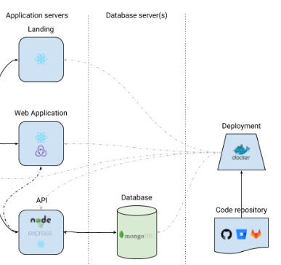
Architecture

